Slide 1
The Pupil Council

Slide 2
What Is The Pupil Council?
The Pupil Council is a group of primary ones to sevens that help throughout the school. We raise funds to get new equipment for the school and to donate to charities.
If you have any ideas for the school or questions for the Pupil Council, you can go to the pupil Council members in your class and they would be happy to listen to ideas and also try to help with any questions.

Slide 3
Our Goals For The School
As Pupil Council members we have many goals for the school such as:
Represent the views of our pupils
Promote positive relationships by leading by example
Lead assemblies
Organise and run school fundraising activities for chosen charities and the school fund

Slide 4
Previous examples of fundraising are -
Mr Fyfe beard shaving
Children in need
Poppy appeal
Red nose day
Stamp design
Switch off fortnight

Slide 5
Our Members are
6/7 - Sophie W and Joshua
5/6 - William and Bridget
4/5 - Hollie P and Kyle
2/3 - Daniel W and Lucy
1/2 - Arran and Ruby

Slide 6
Our Values Are To Always Be
Ready
Respectful
Safe

Slide 7
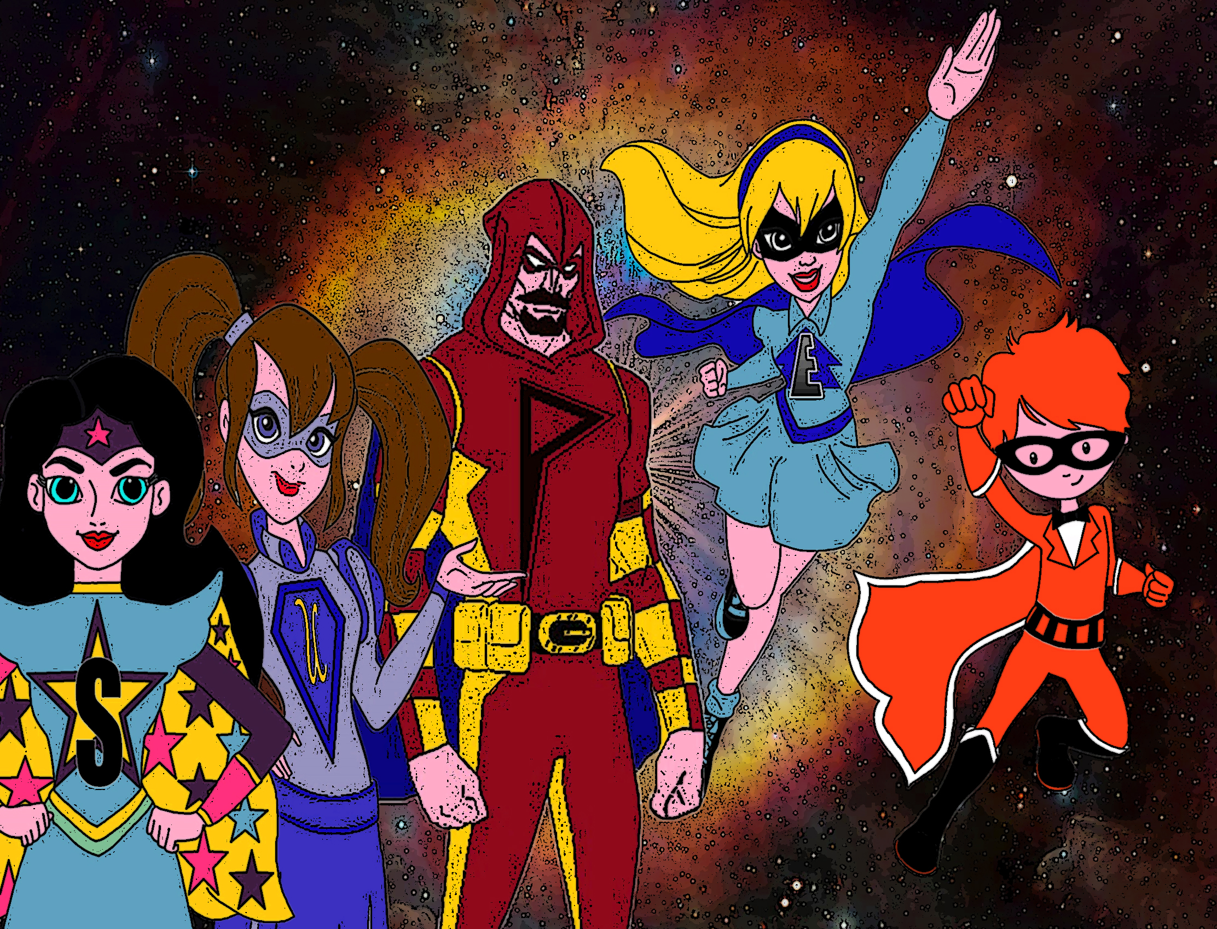
THANK YOU!
And Always
Remember to be SUPER

